Slide 1
CYBER BULLYING TWEET PREDICTION

Slide 2

Team Information :
Adithya Venkatapuram (700742057)
Mohamad Suhail Polur (700745813)
Maher Sarosh Abdul (700736941)
Swathi Jonnalagadda (700744259)

Slide 3
Roles and Responsibilities
Action work | Team Member | Description
Requirement Analysis and papers for project | Adithya | Necessary libraries and IDE tools to implement, required ML Techniques and required journal papers of IEEE for references
Project flow design | Suhail | Project flow is designed the work to each team member such as objectives and problem statement theories and data set to each team member
Data collection from references and data sets | Meher | Data is collected from GitHub repository of journals from references and data sets of different references
Data Exploration- EDA | Swathi and Adithya | Analyzed data on different factors such SVM classifier and Multinomial Naïve Bayes and Logical regressions

Slide 4
Motivation
The goal of the project is to find or filter the abusive messages from the tweets. The challenge with dealing with abusive content is to find or collect the relevant vocabulary of the topic.After collecting the vocabulary we classify the text messages into abusive or normal messages. In this paper we are using n-gram and bi-gram analysis.We use TFIDF vectorizer for feature extraction.After the feature extraction we apply classification algorithms KNN(K-Nearest Neighboring), MNB(Multinomial Naive Bayes) and SVM(Support Vector Machine) algorithms to classify the posts or tweets [1].

Slide 5
Objectives
The main objectives of the project are:
Classifying the text into one of 5 categories of cyberbullying i.e. age, gender, other cyberbullying, religion, ethnicity and normal(not cyberbullying) categories.
To vectorize the text inputs using the Bag of Words model that is a count vectorizer.
Implementing various machine learning models SVM(Support Vector Machine) and Multinomial
Naive Bayes classifiers on the pre-processed text data.
Conducting a comparative analysis with prediction accuracies using precision, recall and F1 score metrics.
Selecting the best model to conclude the whole process.

Slide 6
Problem statement
Cyberbullying is a developing issue that affects millions of individuals worldwide. Cyberbullying may take various forms, including harassment, threats, humiliation, and exclusion, and it can cause victims considerable emotional and psychological suffering. Social media platforms, in particular, have become fertile grounds for cyberbullying, with users frequently concealing their identities in order to unleash assaults on others.
Manually identifying cyberbullying tweets on social media networks may be both time-consuming and emotionally draining. Furthermore, given the volume of information uploaded on these platforms, recognizing and responding to cyberbullying in real time can be challenging.
To solve this issue, a machine learning-based method for automatically detecting cyberbullying tweets on social media sites can be created. The answer

Slide 7
Related work
In this paper we are proposing deep learning techniques to compare the performance of the algorithms on text classification tasks. To classify the text we have implemented the attention based mechanism to classify the text. In this paper we have tested the mechanism on 3 benchmark datasets; those are news dataset, reviews datasets.After applying the classification algorithms we have implemented the applications using high accuracy algorithm [
With deep learning models like BERT(Bidirectional Encodes Representation from Transformers) are used to improve the accuracy of the classifiers. Texts are converted into vectors and the vectors are given as input to the BERT model. This model is tested on the task of MRPC and it gained 93.25 pecentage F1 score on the data. This model can be used in the future evaluation [14]. The applications of text classification are widely spread to different areas like optimising the search engines, news classification , information extraction and preprocessing of electronic emails. The text classification is extended to multiclass classification also. In this paper we have implemented the multiple machine learning models to classify the 5 categories of the news including politics, economy, sports, health and technology.

Slide 8
Proposed Solutions
The proposed solution for cyber bullying tweet prediction using machine learning typically involves a combination of natural language processing (NLP) techniques and machine learning algorithms to classify tweets as containing cyber bullying or not. Here are the main steps involved in the proposed solution:
Data collection and preprocessing: The first step is to collect a large dataset of tweets that contain cyber bullying and those that do not. The tweets are then preprocessed to remove stop words, punctuation, and other noise in the data. The preprocessed tweets are then tokenized and vectorized using techniques such as word embeddings or Bag-of-Words.
Feature extraction: The next step is to extract features from the preprocessed tweets. This can include features such as n-grams, sentiment analysis, emotion detection, and other lexical, syntactic, and semantic features that can help identify cyber bullying content.

Slide 9
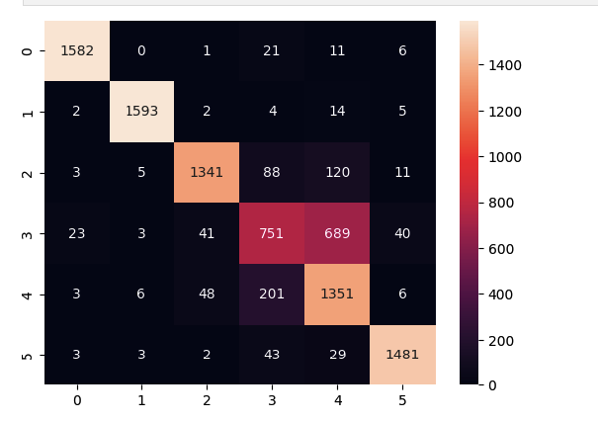
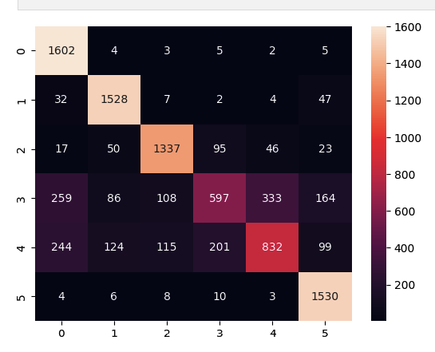
Results /Simulations
RESULTS ANALYSIS A. SVM SVM classifier is used to classify the multi class categories of the cyberbullying corpus. In the first stage data is split into training and testing. After the splitting of whole corpus model is trained using training set and test set or the unseen data is used to evaluate the performance of the data on the cyberbullying classification task. To evaluate the performance of the model various parameters are calculated to compare the accuracy of the test samples.
B. Multinomial Naive Bayes Multinomial Naive Bayes classifier works based on probabilistic learning. This can be used for multi class classification tasks. Our problem type is multi class classification which classifies the cyber bullying categories into one of the predicted categories based on the training accuracy and quality of the data.

Slide 10
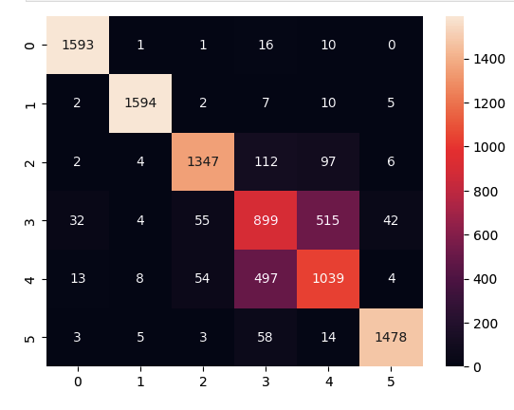
Results/ Simulations
C. Logistic regression Logistic regression is the basic classifier which can be used as baseline model to compare the performance of the models. In this project we have considered the Logistic regression model as the baseline model. This model is imported using scikit-learn library and evaluated using scikit-learn evaluation methods classification report and confusion matrix. The performance of the test samples evaluated using above methods and compared with the other classification models in the project to get the better view of working of the classification task.

Slide 11
Results summary
For model evaluations we use various metrics of accuracy to generalize the model performance. To understand the models in depth using classification reports we publish recall, F1 score and precision metrics.
To measure the separability of the model decision boundary of each model is visualized using scikit-learn library to understand the area under the curve we used ROC-AUC curves.

Slide 12
References
Sakib Al Hasan, Md Gulzar Hussain, Joy Protim, Md Mostafizur Rahman, Nawshad Fahim, Mehrab Zaman Chowdhury, and Ahmed Iqbal Pritom. Classification of multi-labeled text articles with reuters dataset using svm. In 2022 International Conference on Science and Technology (ICOSTECH), pages 01–05. IEEE, 2022.
Shihong Chen, Qichao Kuang, Xiaohui Yu, Suifeng Li, and Ruoyao Ding. A multi-label classification algorithm for non-standard text. In 2022 International Conference on Asian Language Processing (IALP), pages 206–211. IEEE, 2022.
Xiaobo Chen and Huimin Zhang. Rail surface defects detection based on faster r-cnn. In 2020 International Conference on Artificial Intelligence and Electromechanical Automation (AIEA), pages 819–822. IEEE, 2020.
M Tamilselvi, G Ramkumar, G Anitha, P Nirmala, and S Ramesh. A novel text recognition scheme using classification assisted digital image processing strategy. In 2022 International Conference on Advances in Computing, Communication and Applied Informatics (ACCAI), pages 1–6. IEEE, 2022.
Gang Jin. Application optimization of nlp system under deep learning technology in text semantics and text classification. In 2022 International Conference on Education, Network and Information Technology (ICENIT), pages 279–283. IEEE, 2022.
[9] Yajing Ma, Yonghong Li, Xiaolong Wu, and Xiang Zhang. Chinese text classification review. In 2018 9th International Conference on Information Technology in Medicine and Education (ITME), pages 737– 739. IEEE, 2018.

